Slide 1


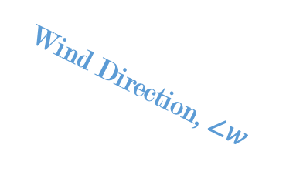






$$y$$
Wind Direction, $∠w$
$$w^{v}$$
$$w^{h}$$
$$x$$
Nacelle Direction, $∠n$
$$n^{c}$$
$$n^{s}$$

Slide 2
Green – removing data
Purple – filling data
Blue – changing data
Orange – rearranging in time
Power-Wind Speed Window Filter
Raw Data
Resample
Forward Fill
Unresponsive Sensor Filter
Power-Wind Speed Window Filter
Feature Transform
Nacelle Calibration
Power Curve Filter
Wind Speed Range Filter
Std. Dev. Filter
Split
Impute
Filtered, Continuous Data
Removing Data
Filling Data
Rearranging in Time
Changing Data

Slide 3













$${\hat{X}}_{\text{p}}$$
$$(B, τ_{p}, d_{y})$$
Output Layer
Stacked Decoder
$$(B, τ_{p}, d_{m})$$
Addition & Normalization
Stacked Encoder
$$(B, τ_{c}, d_{m})$$
FFN
Addition & Normalization
Addition & Normalization
TODO check that this holds for informer, autoformer, spacetimeformer
FFN
Multi-Head Attention
K V
Q
Addition & Normalization
Addition & Normalization
Multi-Head Attention
Masked Multi-Head Attention
K V Q
K V Q
$$(B, τ_{c}, d_{m})$$
$$(B, τ_{p}, d_{m})$$
$$X_{\text{enc}}$$
$$X_{\text{d}\text{ec}}$$
Embedding
Embedding
$$(B, τ_{c}, d_{x})$$
$$(B, τ_{p}, d_{x})$$
$$X_{\text{c}}$$
$$(B, τ_{c}, d_{x})$$
$$X_{\text{p}}$$

